Slide 1

Deep Learning Using Keras in Google Colab
Presented by
Sara Atito Ali Ahmed
Sabancı University
saraatito@sabanciuniv.edu

Slide 2


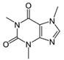







Deep Learning Frameworks
TensorFlow
Keras
Deep learning Toolbox in Matlab
Caffe/Caffe2
Theano
MatConvNet
DL4J
Mxnet
Lasagne
Deeplearning4j
Torch/pyTorch
....

Slide 3
FrameWorks Comparison
All are deep learning frameworks
Open Source
Include scripting and prototyping
Is there a winner?
No strict winners – you have to experiment by yourself and choose the framework that best fits your work and your knowledge.

Slide 4
Which Framework?
Features of a Good Deep Learning Framework:
Preference on the programming language.
Easy to understand and code
Good community support
Parallelize the processes to reduce computations
Automatically compute gradients

Slide 5
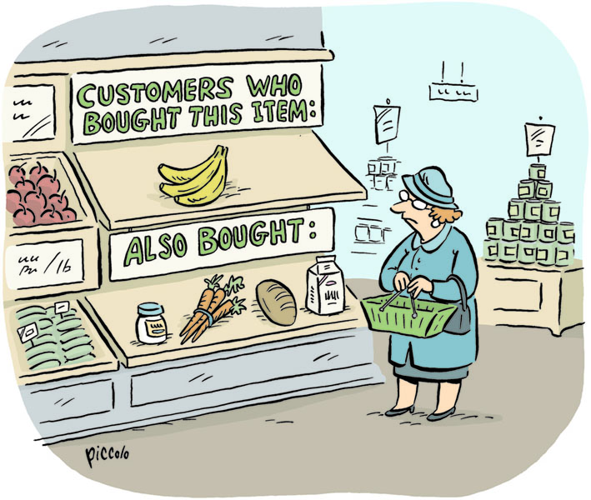

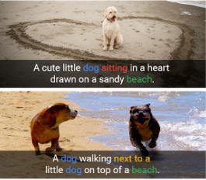

TensorFlow
Developed by researchers at Google Brain
Open Source
Allows distribution of computation
Across different computers
Across multiple CPUs and GPUs within a single machine
Provides a Python and C++ API
Works on mobile devices
Most popular deep learning library for research and production.

Slide 6
TensorFlow
Developed by researchers at Google Brain
Open Source
Allows distribution of computation
Across different computers
Across multiple CPUs and GPUs within a single machine
Provides a Python and C++ API
Works on mobile devices
Most popular deep learning library for research and production.

Slide 7
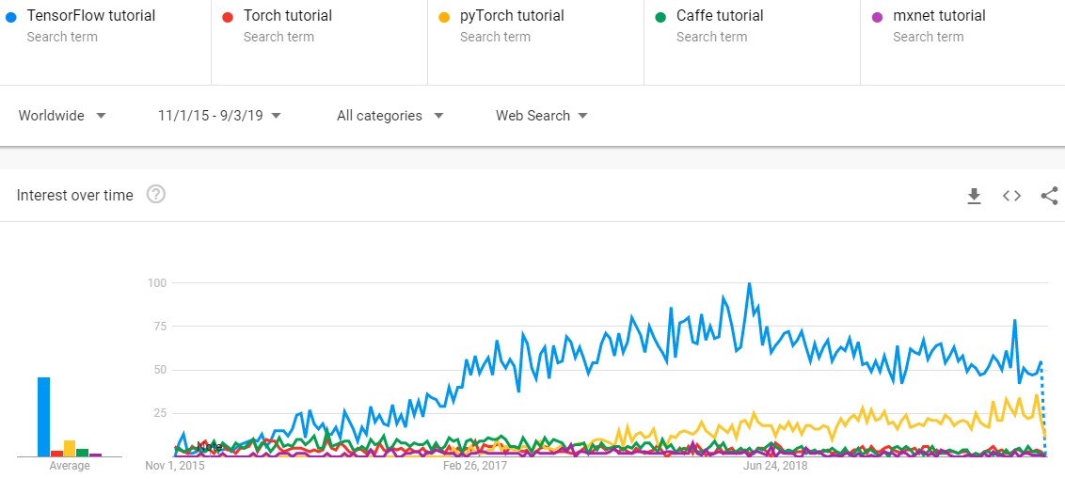
Interest of TensorFlow over Time

Slide 8
KERAS
TensorFlow is the most famous library used in production for deep learning models. However TensorFlow is not that easy to use as it is a low level library.
Keras is a high level API built on TensorFlow (and can be used on top of Theano too).
It is more user-friendly and easy to use as compared to TensorFlow.

Slide 9
Google Colaboratory

Slide 10
What is Google Colab?
It is a free cloud service which supports GPU.
It supports
Python 2.7
Python 3.6

Slide 11
Create a Notebook in Google Colab
Go to Google Colab
https://colab.research.google.com
Click on New Notebook (choose either Python 2 or 3) to create a new notebook.
By default the notebook is created in your Google Drive under Colab Notebooks. Since it’s in Google Drive, you can move it around and share it just like any other Drive documents.

Slide 12
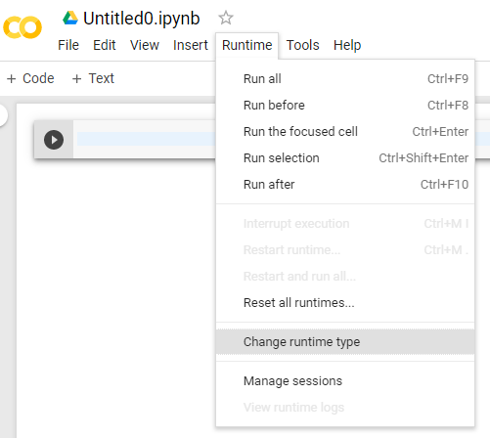
Enable GPU Acceleration
Go to runtime/change runtime type, select GPU for hardware acceleration. Now you can run your training on GPU for free!

Slide 13
Hands On #1 Build a Convolutional Neural network for training and classifying MNIST dataset.

Slide 14
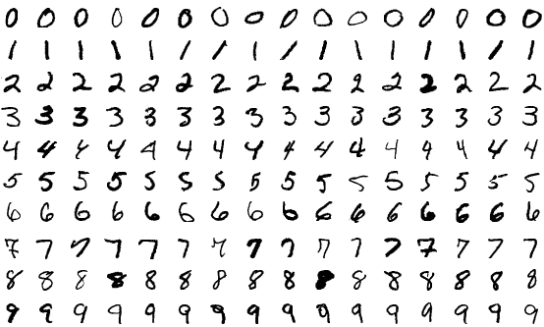
MNIST Dataset
MNIST is a dataset of handwritten digits
It consists of:
Training set: 60,000 samples
Testing set: 10,000 samples

Slide 15
Steps for Image Classification with CNN
Load the dataset
Pre-processing
Data augmentation [optional]
Create a model
Train the model using the training set
Evaluate the model using the validation set

Slide 16
Loading MNIST dataset
Keras provides seven different datasets, which can be loaded in using Keras directly.
The datasets include image datasets as well as a house price and a movie review datasets.
Loading MNIST dataset
from keras.datasets import mnist
(x_train, y_train), (x_test, y_test) = mnist.load_data()

Slide 17
Pre-processing
Transform the images to four dimensions to feed the images to a convolutional neural network.
This can be done using numpys reshape method.
x_train = x_train.reshape(x_train.shape[0], x_train.shape[1], x_train.shape[2], 1)
x_test = x_test.reshape(x_test.shape[0], x_test.shape[1], x_test.shape[2], 1)

Slide 18
Pre-processing
Transform the data into floats and Normalize it.
Transform labels into a one-hot encoding
x_train = x_train.astype('float32')
x_test = x_test.astype('float32')
x_train /= 255
x_test /= 255
from keras.utils import to_categorical
y_train = to_categorical(y_train, 10)
y_test = to_categorical(y_test, 10)

Slide 19
Creating a model
The easiest way of creating a model in Keras is by using the sequential API.
model = Sequential()
model.add(Conv2D(32, kernel_size=(3, 3), activation='relu', input_shape=input_shape))
model.add(MaxPooling2D(pool_size=(2, 2)))
model.add(Dropout(0.25))
model.add(Conv2D(32, kernel_size=(3, 3), activation='relu', input_shape=input_shape))
model.add(MaxPooling2D(pool_size=(2, 2)))
model.add(Dropout(0.25))
model.add(Flatten())
model.add(Dense(128, activation='relu'))
model.add(Dropout(0.5))
model.add(Dense(50, activation='relu'))
model.add(Dense(num_classes, activation='softmax'))

Slide 20
Compile the model
Configure the learning process.
Specify an optimizer, a loss function and optionally some metrics like accuracy.
The loss function is a measure on how good our model is at achieving the given objective.
An optimizer is used to minimize the loss(objective) function by updating the weights using the gradients.
model.compile(loss=categorical_crossentropy, optimizer=adam, metrics=['accuracy'])

Slide 21
Fit the model
Now as the model is defined and compiled, it’s ready for training.
There are two fit functions that can be used to train your models
fit() where you pass your whole dataset at once.
fit_generator(), the data is coming from a generator that is used to feed the network batch by batch. Normally used with large dataset.
model.fit(x_train, y_train, batch_size=32, epochs=2)

Slide 22
Data augmentation
Augmentation is a process of creating more data from existing once, like rotating the image, zooming into the image, adding noise and many more.
Keras has a method called ImageDataGenerator which can be used for augmenting images.
from keras.preprocessing.image import ImageDataGenerator
datagen = ImageDataGenerator(
rotation_range=10,
zoom_range=0.1,
width_shift_range=0.1,
height_shift_range=0.1)

Slide 23
Fit the model with fit_generator()
After creating an image generator, we can use fit_generator()
model.fit_generator(datagen.flow(x_train, y_train, batch_size=32), epochs=2)

Slide 24
Hands On #2 Transfer Learning using MNIST dataset.

Slide 25
Transfer Learning
Convolutional neural networks require large datasets and a lot of computational time to train.
It is relatively rare to have a dataset of sufficient size.
Instead of training the network from scratch, transfer learning utilizes a trained model on a different dataset, and adapts it to the problem that we're trying to solve.

Slide 26
Transfer Learning
There are two strategies
ConvNet as fixed feature extractor
Remove the last layer
Freeze the weights
Train machine classifier on the network output
Fine-tuning the ConvNet.
Use weights of trained model as an initialization to the network.

Slide 27
Loading and Preprocessing
Loading and preprocessing of MNIST dataset is similar to hands on #1
The only difference is that, we have to convert MNIST dataset to RGB instead of Grey scale
x_train = [cv2.cvtColor(cv2.resize(i, (32,32)), cv2.COLOR_GRAY2BGR) for i in x_train]
x_train = np.concatenate([arr[np.newaxis] for arr in x_train]).astype('float32')
x_test = [cv2.cvtColor(cv2.resize(i, (32,32)), cv2.COLOR_GRAY2BGR) for i in x_test]
x_test = np.concatenate([arr[np.newaxis] for arr in x_test]).astype('float32')

Slide 28
Pretrained Models in Keras
Keras Applications offer 10 pretrained models for image classification with weights trained on ImageNet.
These models can be used for prediction, feature extraction, and fine-tuning.
In this tutorial, we will use VGG16.
Follow the Notebook for the full example.

Slide 29
CAFFE

Slide 30
Caffe Convolution Architecture for Fast Feature Embedding
Open-Source framework for deep learning
Pure C++/CUDA architecture for deep learning
Command line, Python, and Matlab interfaces
Fast, well-tested code
Seamless switch between CPU and GPU
http://caffe.berkeleyvision.org/

Slide 31
Caffe Layers
Caffe model
The model architecture should be defined in a protocol buffer definition file (prototxt)
Layer Catalogue
Data Layers
Vision Layers
Recurrent Layers
Common Layers
Normalization Layers
Activation / Neuron Layers
Utility Layers
Loss Layers

Slide 32
Data Layer
Image Data
Read raw images
Database
LevelDB
LMDB
HDF5 input

Slide 33
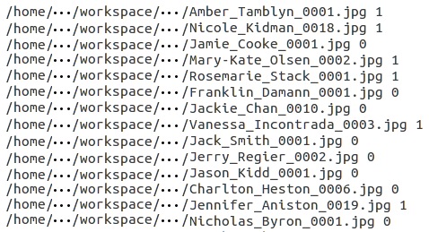
Data Layer – Image Data
Require: name of a text file, with each line giving an image filename and label
layer {
name: “data“
type: “ImageData"
top: "data"
top: "label"
include {
phase: TRAIN
}
data_param {
source: “path/to/the/txt/file"
batch_size: 20
new_height: 256
new_width: 256
}
transform_param {
mirror: true
Crop_size: 224
mean_file: “/path/to/the/mean/file”
}
}

Slide 34
Vision Layers
Convolution Layer
Convolves the input image with a set of learnable filters
Pooling Layer
Max, Average, or Stochastic pooling
Deconvolution Layer
Transposed convolution
Crop
Perform cropping transformation

Slide 35
Vision Layer – Convolution Layer
Convolves the input image with a set of learnable filters
layer { name: "conv1”
type: "Convolution"
bottom: "data"
top: "conv1”
convolution_param {
num_output: 96
kernel_size: 11
stride: 4
weight_filler {
type: "gaussian"
std: 0.01
}
bias_filler {
type: "constant"
value: 0
}}}
Required!!

Slide 36
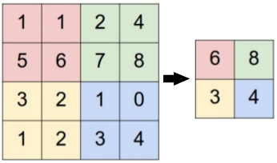
Vision Layer - Pooling
Max, Average, or Stochastic pooling
Layer{
name: "pool1"
type: "Pooling"
bottom: "conv1"
top: "pool1"
pooling_param {
pool: MAX
kernel_size: 2
stride: 2
}
}
Required!!
Max-Pooling

Slide 37
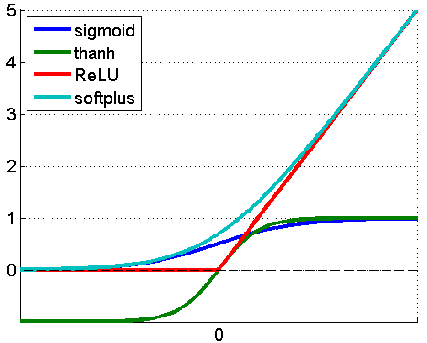
Activation Layers
RelU
PRelU
Sigmoid
TanH
Absolute Value
Exp
Log

Slide 38
Activation Layers
RelU
PRelU
Sigmoid
TanH
Absolute Value
Exp
Log
..
layer {
name: "relu1"
type: "ReLU"
bottom: "conv1"
top: "conv1"
}

Slide 39
Common Layers
Inner product
Fully connected layer
DropOut

Slide 40
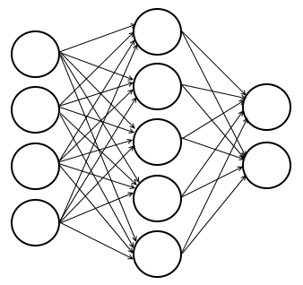
Common Layers – Inner Product
Fully connected layer
layer
name: "fc2“
type: "InnerProduct"
bottom: "fc1"
top: "fc2"
inner_product_param {
num_output: 1000
weight_filler {
type: "gaussian"
std: 0.01
}
bias_filler {
type: "constant“
value: 0
}
}
}
Required!!

Slide 41
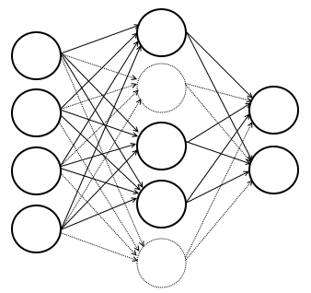
Common Layers - DropOut
During training only, sets a random portion of the input layer to zero
layer {
name: "drop1"
type: "Dropout“
bottom: "fc1"
top: "fc1"
dropout_param {
dropout_ratio: 0.5
}
}

Slide 42
Loss Layer
Softmax with loss
computes the multinomial logistic loss of the softmax of its inputs.
Euclidean
computes the sum of squares of differences of its two inputs
Sigmoid Cross-Entropy loss
computes the cross-entropy (logistic) loss

Slide 43
Loss Layer – Softmax with loss
Computes the multinomial logistic loss of the softmax of its inputs.
layer {
name: "loss"
type: "SoftmaxWithLoss"
bottom: "pred"
bottom: "label"
top: "loss"
loss_param {
ignore_label: 255
}
}

Slide 44
Solver Prototxt
Network run parameters
net: “/path/to/train/prototxt"
test_iter: 500
test_interval: 1000
base_lr: 0.01
lr_policy: "step"
gamma: 0.1
stepsize: 100000
display: 20
max_iter: 450000
momentum: 0.9
weight_decay: 0.0005
snapshot: 10000
snapshot_prefix: “/path/to/save/model"
solver_mode: GPU

Slide 45
Running Caffe – Command Line
Training from scratch
./build/tools/caffe train -solver Path/to/solver.prototxt
Training by finetuning
./build/tools/caffe train -solver Path/to/solver.prototxt -weights Path/to/caffenet.caffemodel
Resume training from snapshot
./build/tools/caffe train -solver Path/to/solver.prototxt -snapshot Path/to/caffenet.solverstate
Testing
./build/tools/caffe test -model Path/to/train_val.prototxt -weights Path/to/caffenet.caffemodel -iterations 100

Slide 46
Application
Face attributes classification
Dataset:
LFW
CelebA
In total: 200,000 training samples
Datasets are annotated with 40 attribute classes

Slide 47
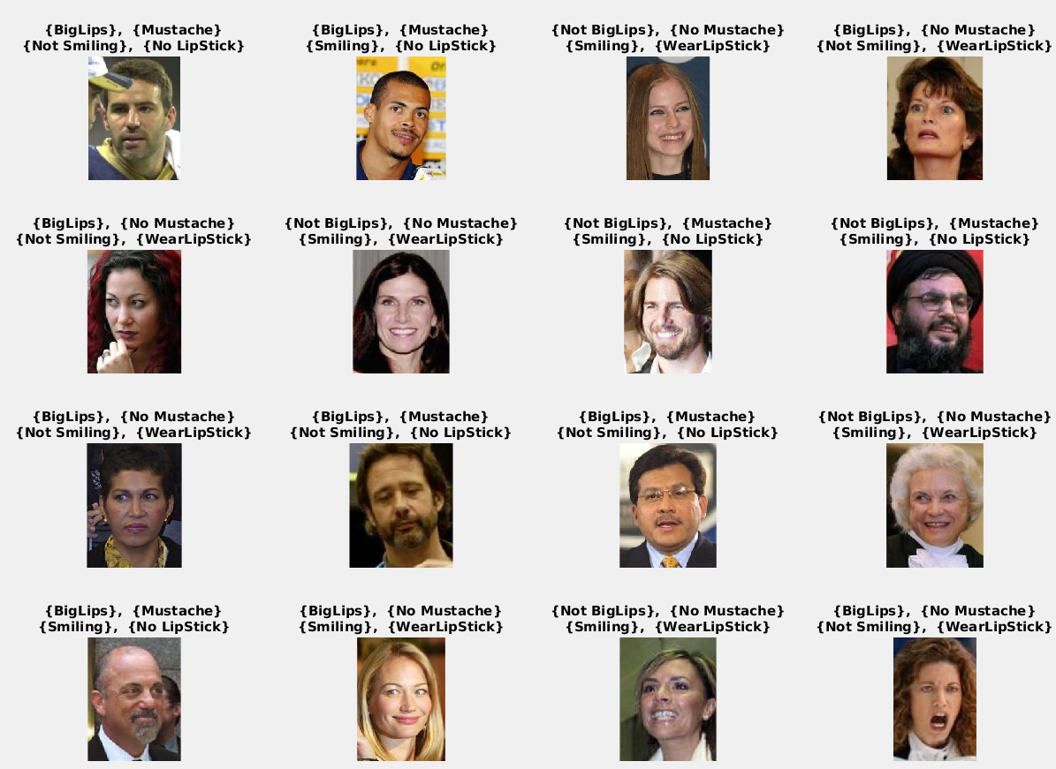

Slide 48
Matlab

Slide 49
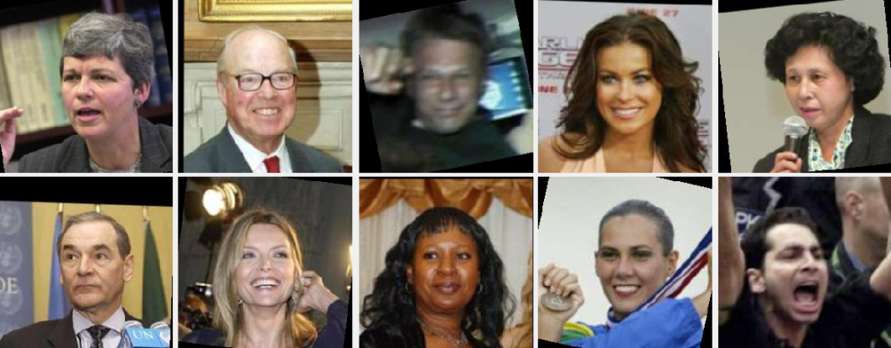
Toy Example
Gender Classification
Dataset: Part of LFWA
Training samples: 4500 samples
Testing samples: 2000 samples
Architecture: XceptionNet
Apply Transfer Learning

Slide 50
Build a CNN for Gender Classification
Load The dataset
load(‘TrainImgs.mat’); load(‘TrainLbls.mat’);
load(‘TestImgs.mat’); load(‘TrestLbls.mat’);
imageSize = [299,299,3];
imds_Train = imageDatastore(TrainImgs, 'Labels', categorical(TrainLbls)); auimds_Train = augmentedImageDatastore(imageSize, imds_Train); imds_Test = imageDatastore(TestImgs, 'Labels', categorical(TestLbls)); auimds_Test = augmentedImageDatastore(imageSize, imds_Test);

Slide 51
Create the model
net = xception; lgraph = layerGraph(net); lgraph = removeLayers(lgraph, 'ClassificationLayer_predictions'); lgraph = removeLayers(lgraph, 'predictions_softmax'); lgraph = removeLayers(lgraph, 'predictions'); lgraph = addLayers(lgraph, fullyConnectedLayer(2, 'Name', 'mypredictions')); lgraph = connectLayers(lgraph, 'avg_pool', 'mypredictions');
lgraph = addLayers(lgraph, softmaxLayer('Name', 'mypredictions_softmax')); lgraph = connectLayers(lgraph, 'mypredictions', 'mypredictions_softmax'); lgraph = addLayers(lgraph, classificationLayer('Name', 'myClassificationLayer_predictions')); lgraph = connectLayers(lgraph, 'mypredictions_softmax', 'myClassificationLayer_predictions');

Slide 52
Training the model
options = trainingOptions('sgdm', ... 'MiniBatchSize', 32, ... 'MaxEpochs', 5, ... 'Shuffle','every-epoch', ... 'ValidationData', auimds_Test, ... 'ValidationFrequency', 50, ... 'Verbose',false, ... 'Plots','training-progress');
net = trainNetwork(auimds_Train, lgraph, options);
Testing the model
Yhat = classify(net, auimds_Test)
Gt = categorical(TestLbls);
Acc = 100*mean(Yhat(:) == Gt(:) );

Slide 53
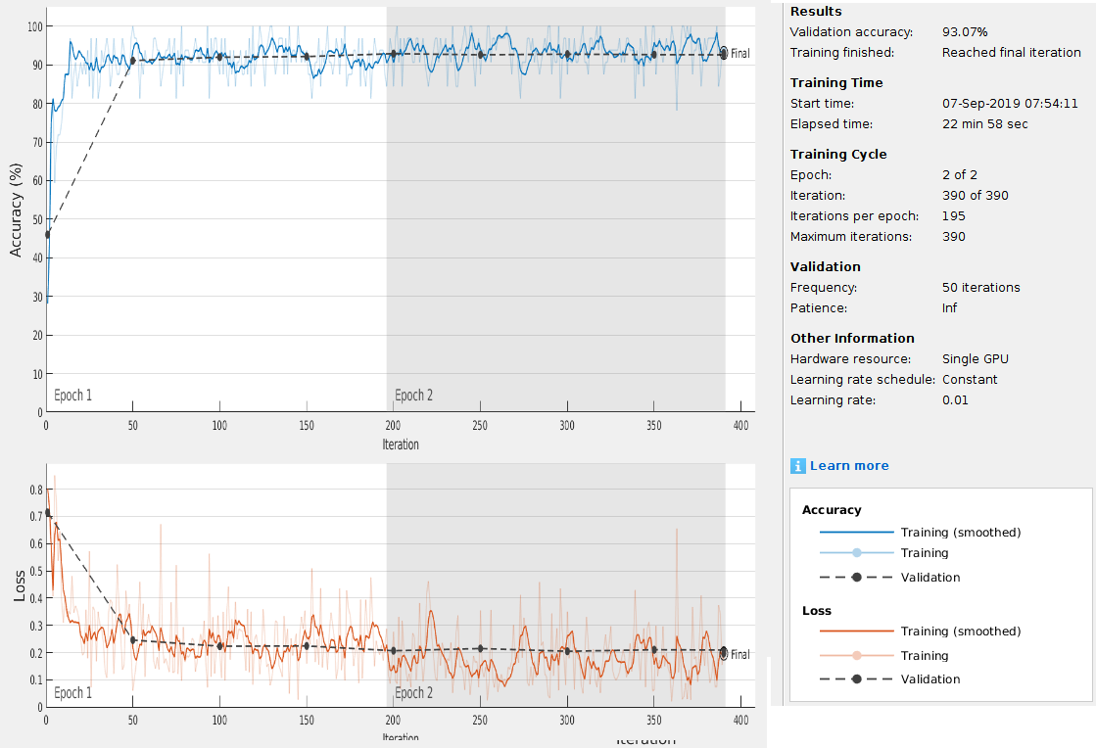

Slide 54
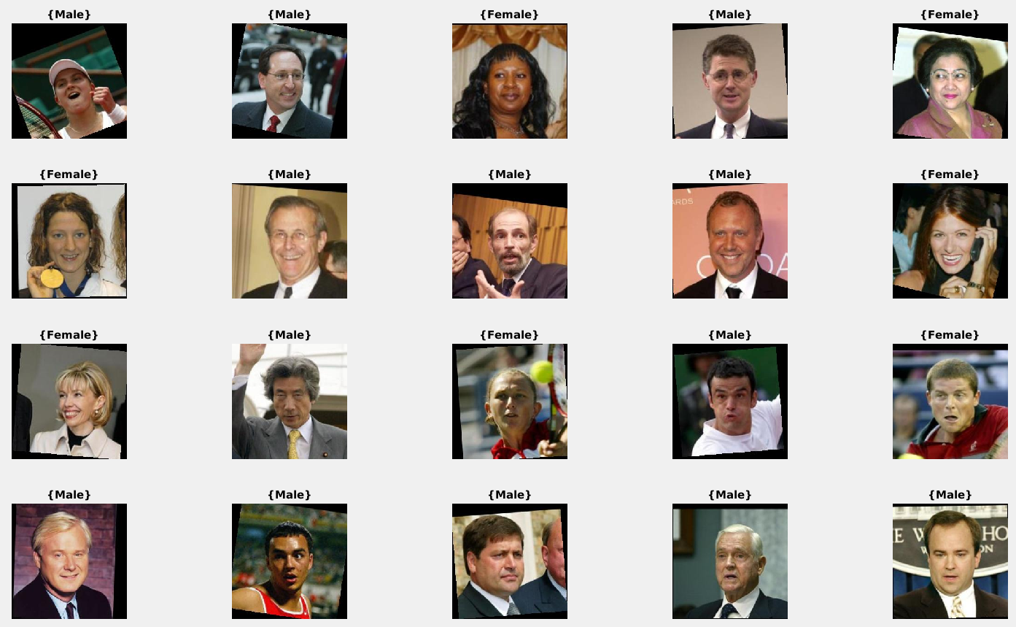

Slide 55
Thank You ☺

